Slide 1
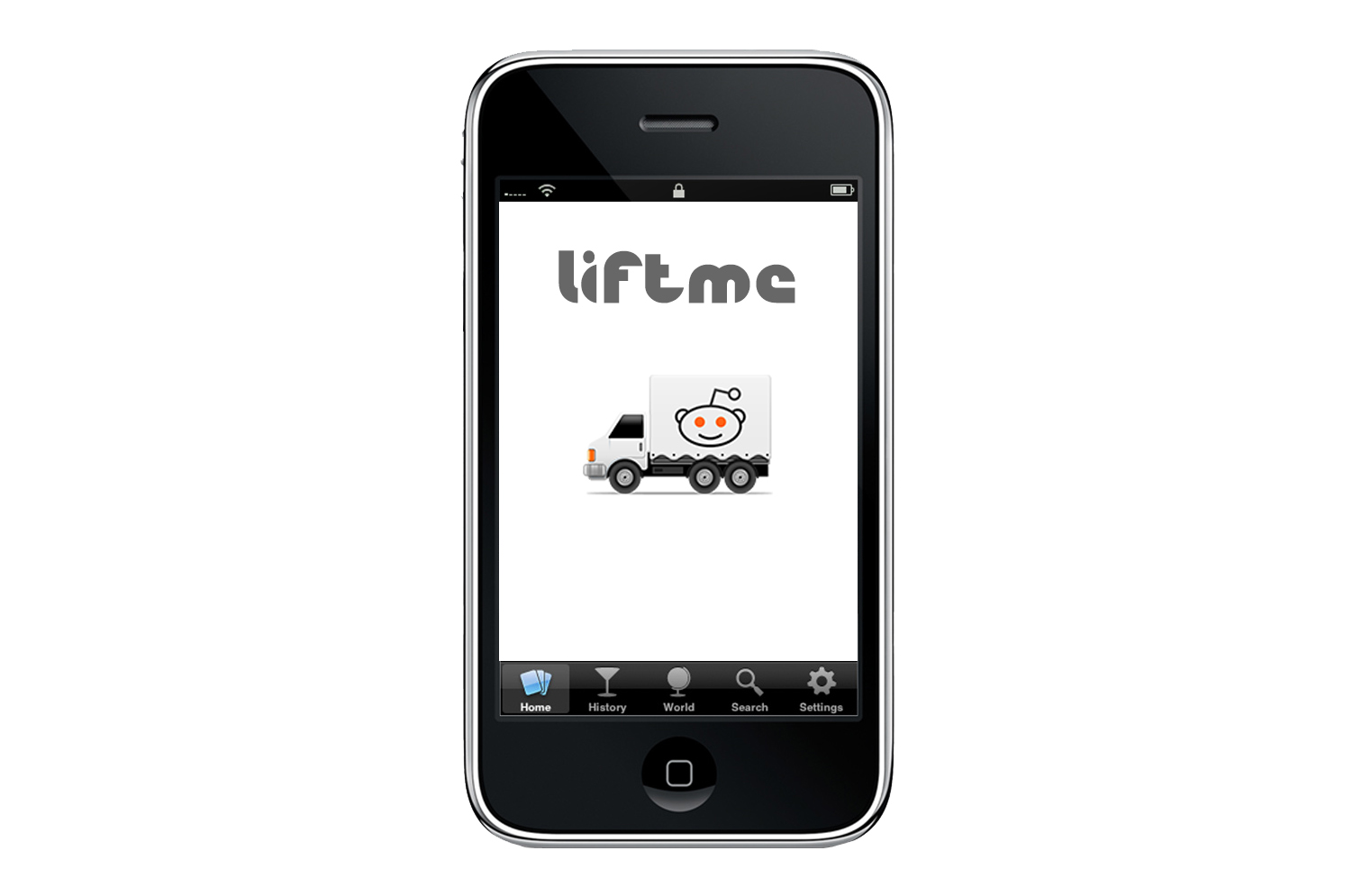

Slide 2
LiftMe Car sharing when you need it.
Team 2
Mark Addison
Emre Bakkaloglu
Michelle Coates
Evgeny Labzin
Richard Ogodeton
Paul-Michael Sorhaindo

Slide 3
Mission Statement
LiftMe aims to give users a more efficient and ecologically friendly way to travel. It will take the hassle out of finding other people going to the same destinations and provide a flexible adhoc basis for saving travel costs.

Slide 4
LiftMe Features
Register via your android phone
View all available cars on a map or in a list
Browse rides by location and date
Book and pay for rides online (refunds for no shows)
Suggested driver fee based on distance
View and edit your LiftMe account
Shake your phone to find the nearest available Lifter
View photos and ratings of other LiftMe users in the gallery

Slide 5
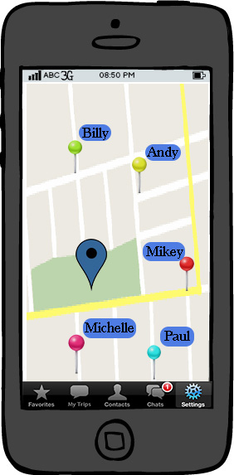
LiftMe Design
This is the main screen of the app
It shows the current location of the user and other ping users around the user, with their usernames.
The user can touch the other users to send a message or he can zoom in or out.
He can pulls the search tab from the top of the screen.
At the bottom there is the options tab where the user can look at his favorite users, previous trips, contacts, chats and settings

Slide 6
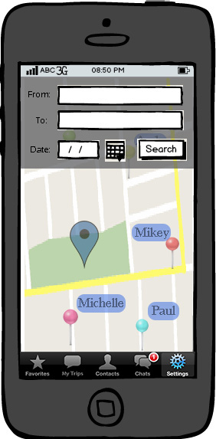
The Search Tab
Here is the search tab of the app.
The user enters the location and the destination with the date and time and searches that who is going or passing from that route.
The map is active at the backround, the opticality is a bit low.

Slide 7
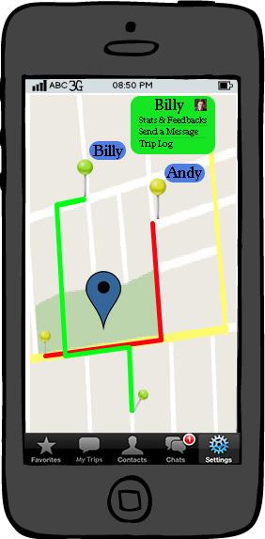
Interacting with Other Users
After the user enters the route, the app shows other users passing or going to the same direction.
The user can tap on the user to send a message, see the feedbacks about him and to look at the trip log.

Slide 8
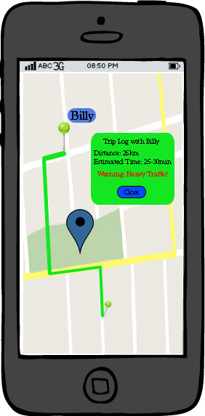
Trip Log Interface
Here is the trip log interface of the app.
It shows the distance and estimated travel time to the user.
The app looks at the traffic and than calculates the estimated time. If there is heavy traffic, than it warns the user.

Slide 9
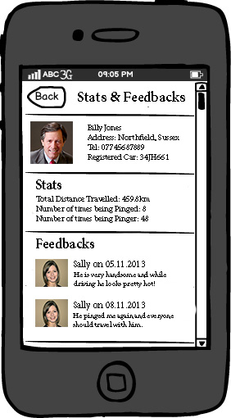
Feedback
Here is the stats & feedbacks page of the app where the user can see detailed information about a specific user.
The address, Tel No, and the registered car info are appeared on the screen together with stats of previous trips and feedbacks from other users.

Slide 10
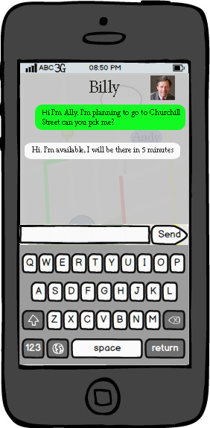
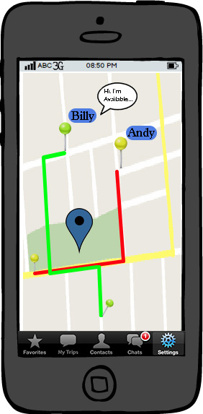
Interacting with Other Users
Here is the chat screen between the user
It is a bit transparent and the map is still active on the background.
There is also a profile picture of the other user.

Slide 11
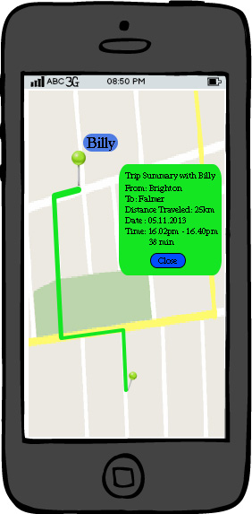
Trip Summary
On reaching the destination the app will recognise the change in location and prompt the user for feedback.
The user can also see this trip summary and the other trip summaries from my trips at the option bar at the bottom.

Slide 12
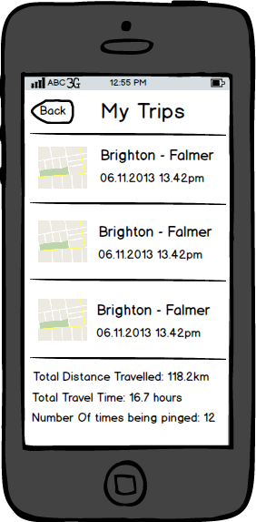
My Trips
Here is the my trips page where the user can see his previous trips and total stats at the bottom of the page.
User can tap on the trip to see the trip on the map with detailed information.

Slide 13
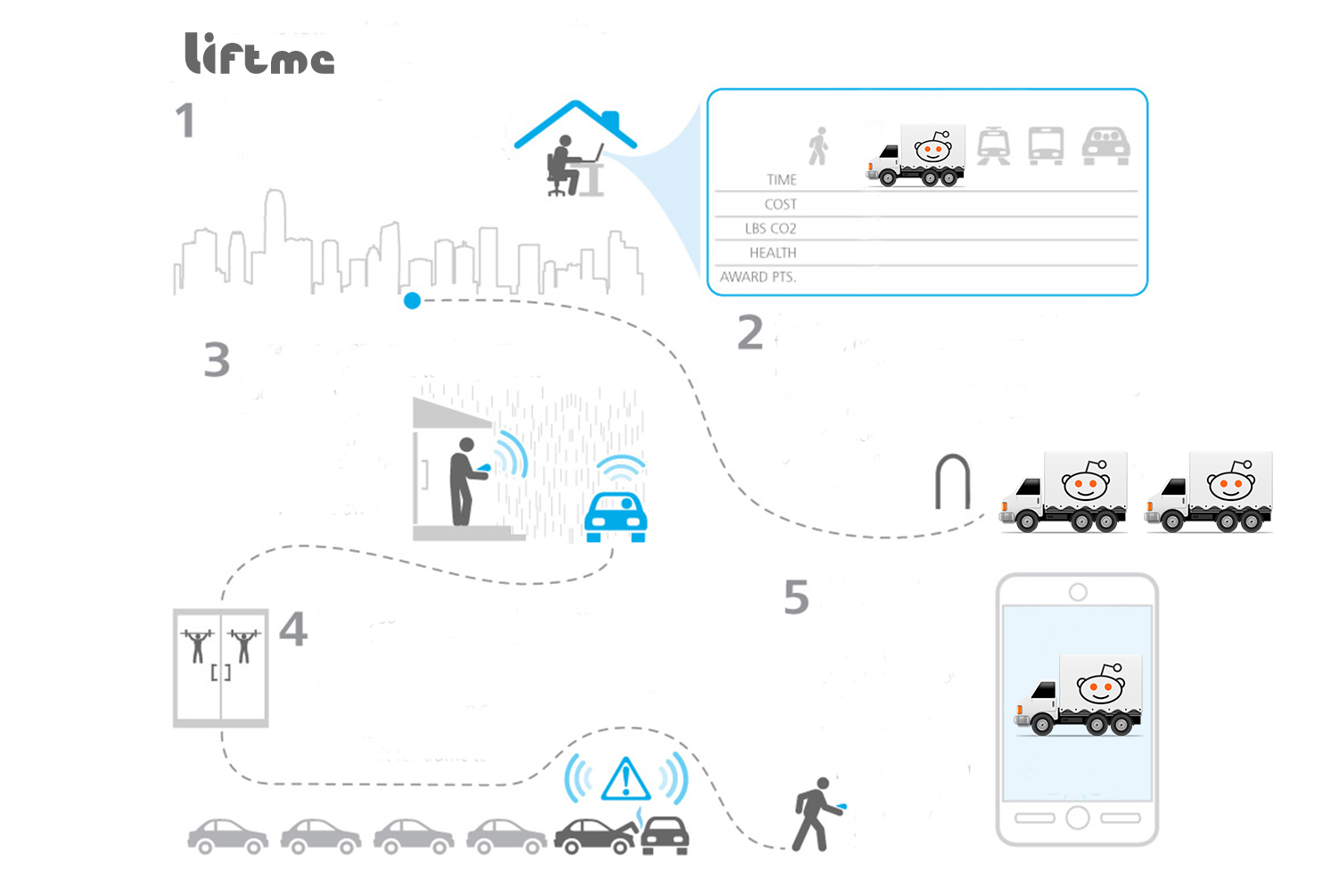
USER SCENARIO 1
From home in the morning ,you need to get across town for afternoon meeting with a client.
A quick compares of time, cost carbon foot print associated with all your personal travel options, you see that there are other apps user within a couple blocks of your office client & opt to
grab a car
share across town.
It’s raining when you are meeting wraps up, so you opts to share a ride to the gym after work.
You pull up your
Liftme app and see
that a driver headed
In the same direction is
just a few blocks away.
When you get out from the locker you have an alert there is accident a half mile from your apartment & traffic at stand still. You opt to burn
Off some more additional
Calories & walk home rather wait for the traffic.
When you get home you log the day trip to see the summary page & how you have help to reduce traffic and emission

Slide 14
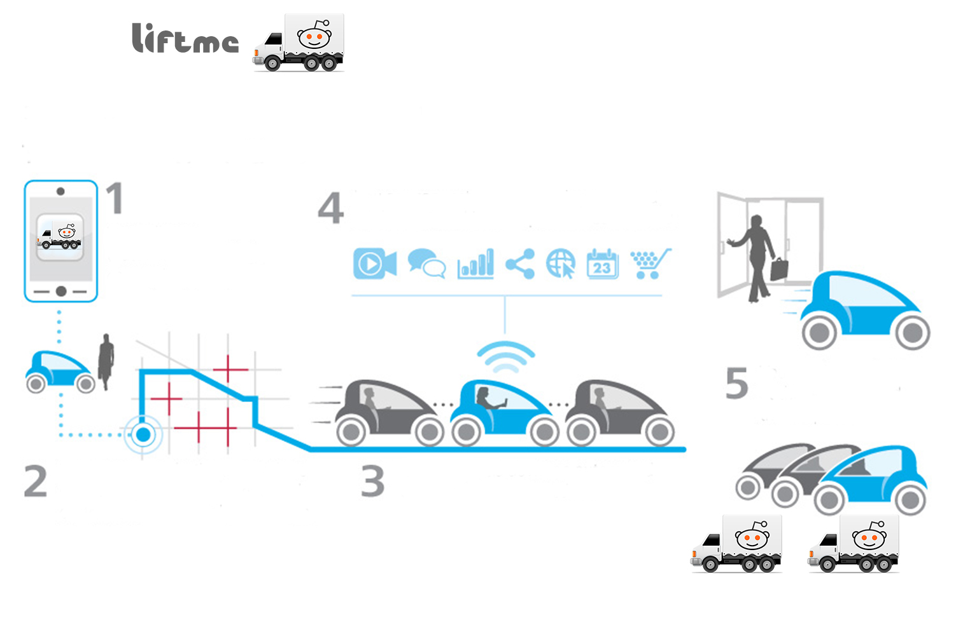
USER SCENARIO 2
You are drop off at the door step of your home and the car drive off with a smile☺
Bob’s open the (liftme )apps,
log in and look for other user, using same app.
You are connected to everything you need while you travelling in the car smile☺
You enter your destination ,date time, and dynamically send’s your information to the cloud system.
Your car travel road way with other user, who don’t have the app yet

Slide 15
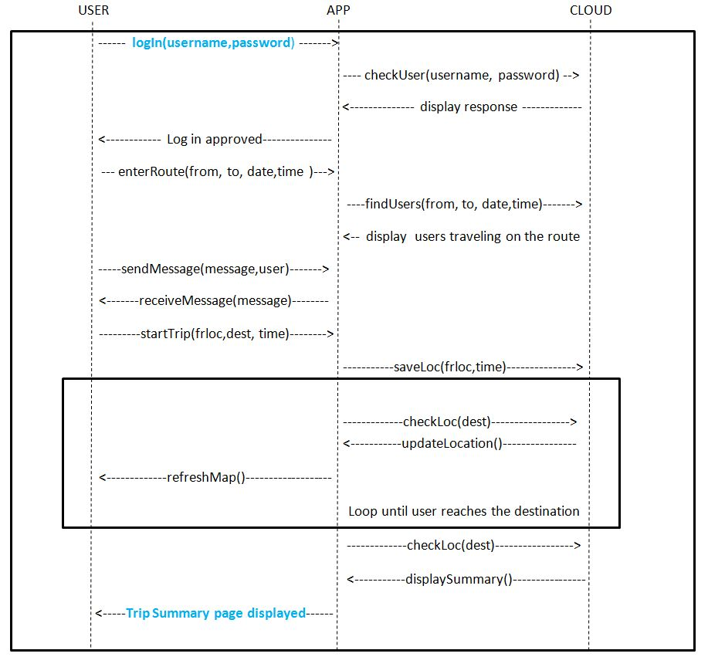
System Sequence Diagram

Slide 16
LiftMe Architecture

Slide 17
Client Server Protocol
Login: Request/Resp
Update Profile: Request/Resp
Update Travel Schedule: Request/Resp
Request Lift: Request/Resp
* Send Liftee request to chosen Lifter: Sever request/Client Resp
And many others.
All communication will be in the form of valid XML files.
Communication between client and Server will be via Java sockets.

Slide 18
Client
Java code utilising the Android SDK.
Utilizing the Google’s Android API to display maps.
Displaying fast intuitive User Interface.
Storing data locally (to an SD card) when the device has no access to internet.
Syncing stored data with the server once internet access is regained.
Displaying dynamic overlays while a map is being shown.

Slide 19
Server
Developed in Java.
Queries and updates a MySQL database.
We will take care to avoid data redundancy during the design of the database.
Processes data within the database to provide suitable responses for the User.
Will potentially look at a RESTful approach given time.
A working prototype is already developed using Java Sockets.

Slide 20
Third Party API’s
Facebook API
Sign in with…
Profile picture usage
Chat API integration (potential extension)
Google Maps API
making use of geo-location data and displaying maps

Slide 21
Project Methodology
Based on SCRUM
Look to meet Tuesday, Thursday and Friday
Tuesday to review project & product
Thursday – Retrospective and planning
Friday – Make sure that we update the sprint board and clear on objectives
Manage Product Backlog and Sprint tasks on Trello – SCRUM board
5 columns
Product Backlog
Sprint tasks
Communicate via the Forum if have problems or request further meetings

Slide 22
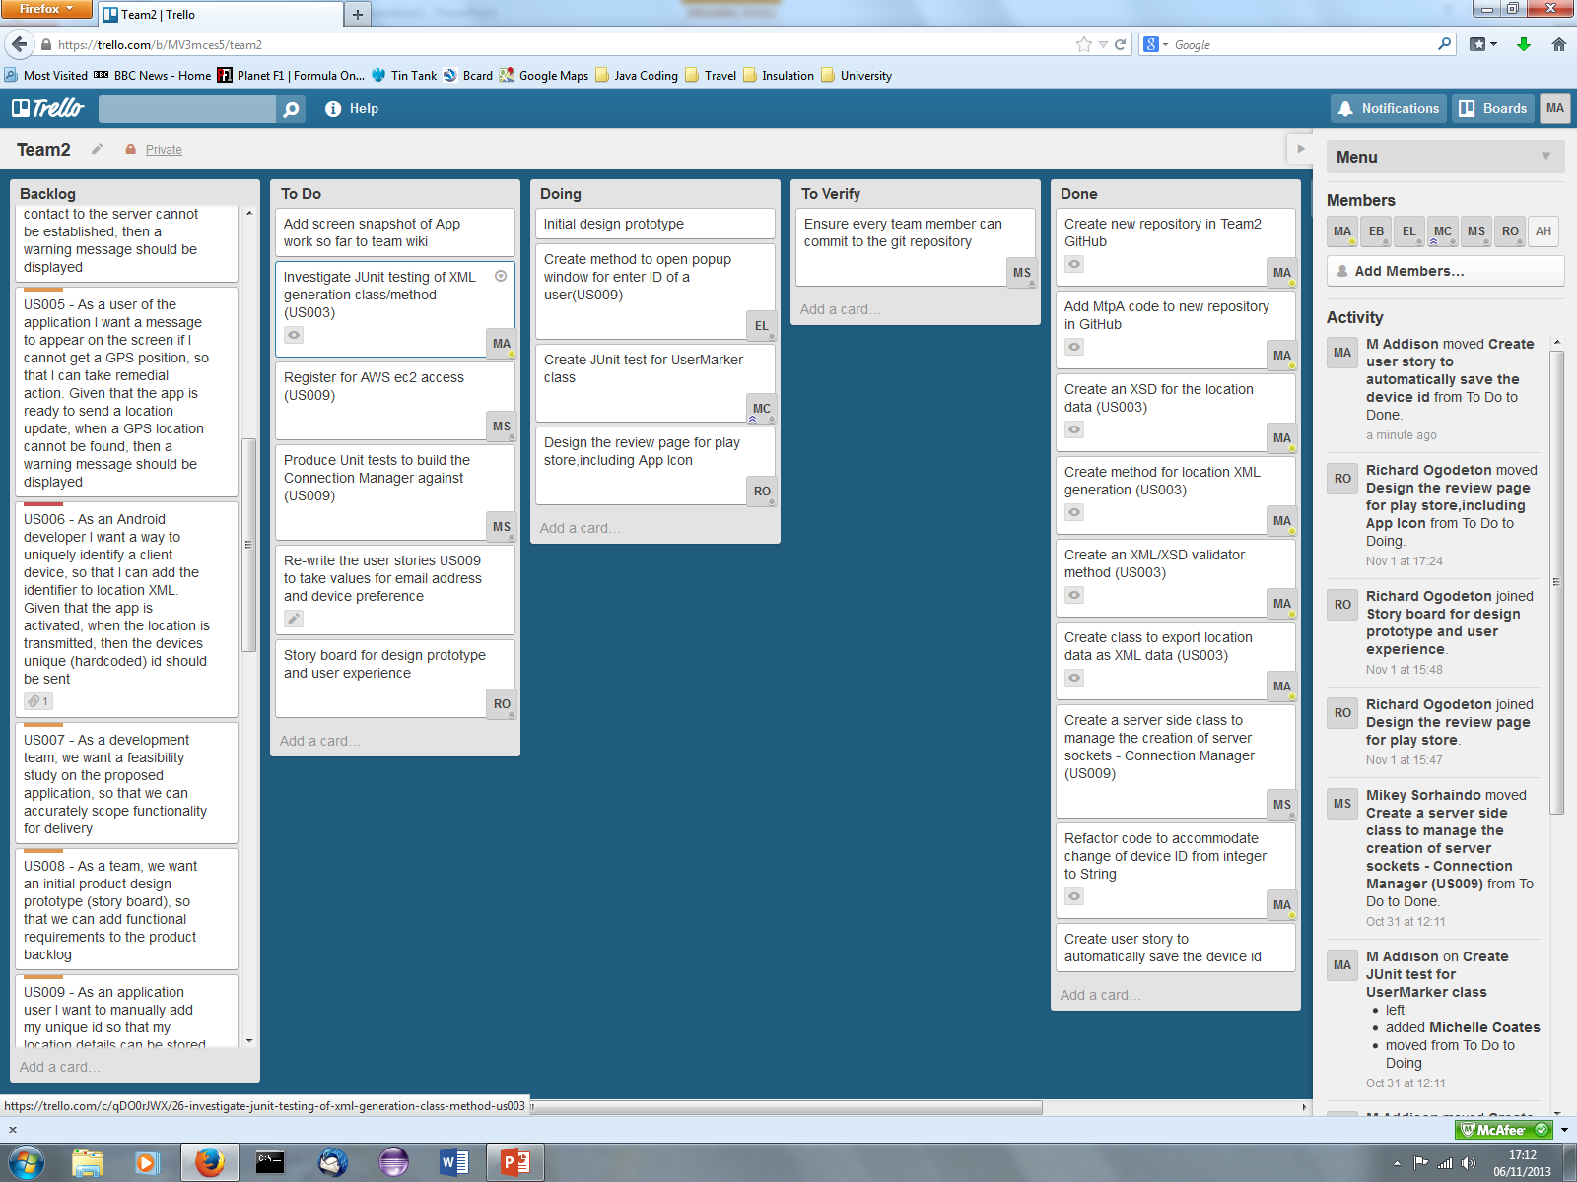
Project Methodology

Slide 23
Project Methodology
Defining user requirements – User Stories
Atomic
Widely used
Easy to understand
Lightweight
Requirement
As a (user), I would like (functionality), so that I can (complete some action)
Acceptance criteria
Given that (starting condition), when I (perform a action), then (a result)

Slide 24
GitHub & Testing
Code stored under a MAIN branch
Coders take copy and refresh their local versions
Make a local branch – do changes
Merge back to the MAIN branch and push to GitHub
Unit testing
Test Driven Development
Initial tests added retrospectively to get used to JUnit
JUnit
Release testing
Requirements – Based on the story acceptance criteria
Scenario – A simple walk through case

